Slide 1
Fraud Detection
IST 718
03/25/2023
Toby Anderson

Slide 2
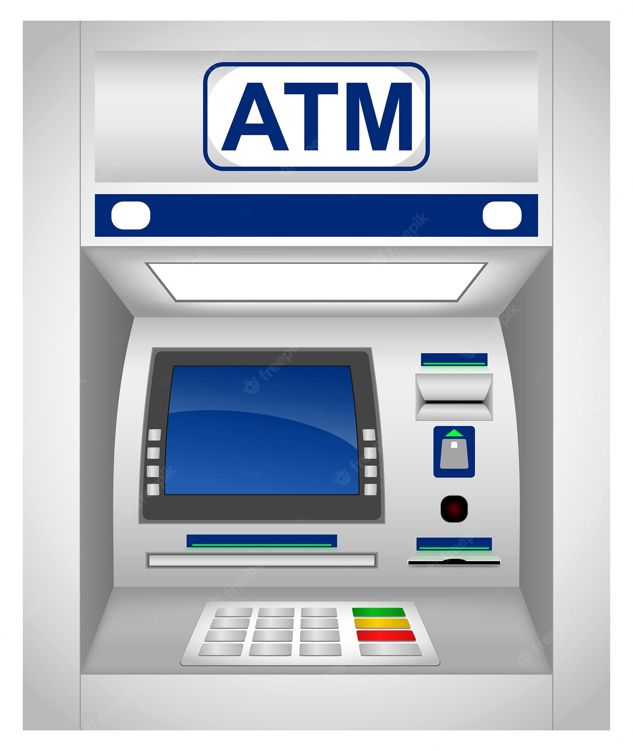
Introduction
Can fraudulent transactions be detected by analyzing transaction history?
What are the main indicators of a transaction being fraudulent?

Slide 3
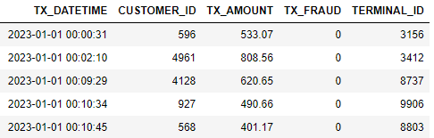
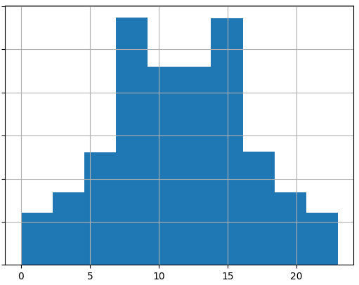
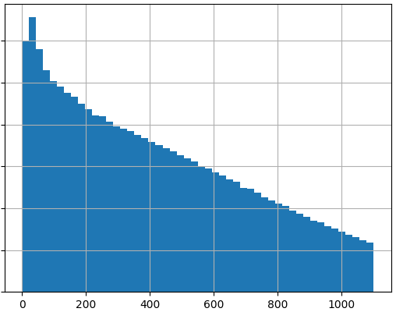
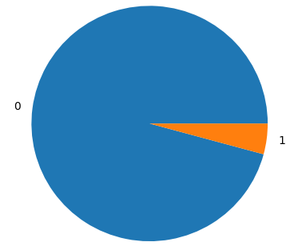
Data Exploration
Nearly 2m records sourced from Kaggle dataset.
Data Sample
Hour-of-day distribution
Dollar amount distribution
Class Imbalance

Slide 4

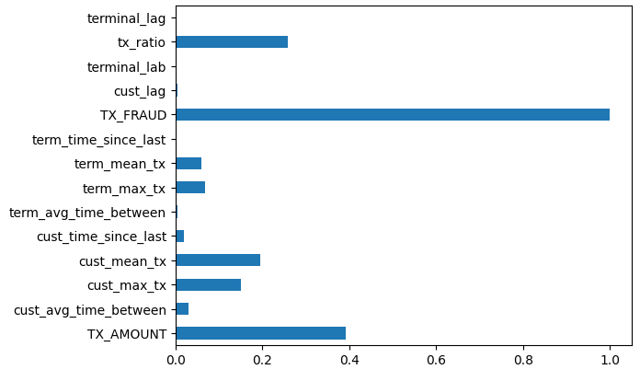
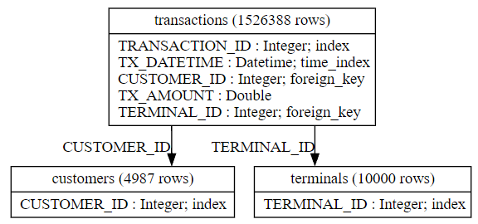
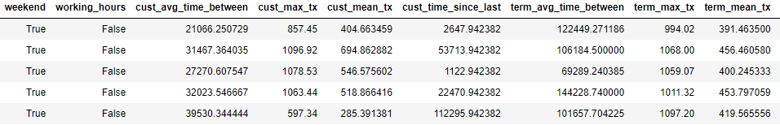
Feature Engineering
Data Structure
Feature Correlation
Sample of Features

Slide 5
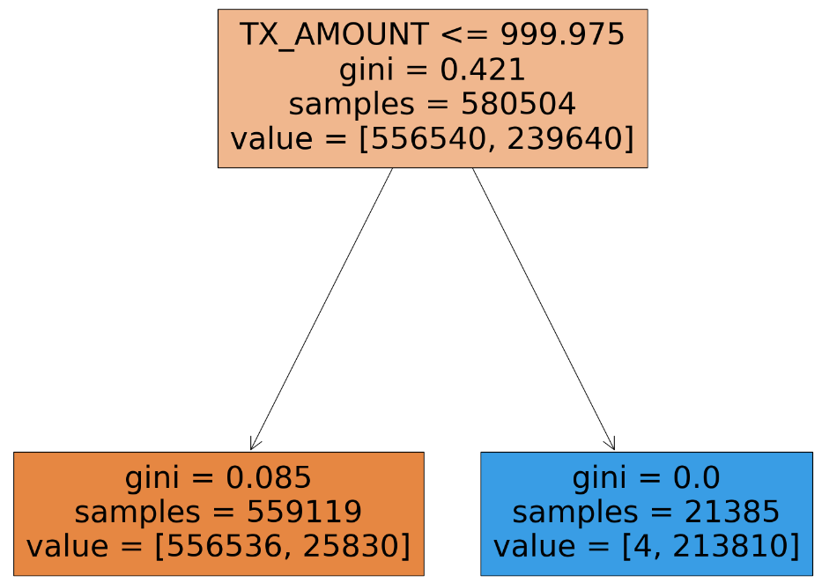
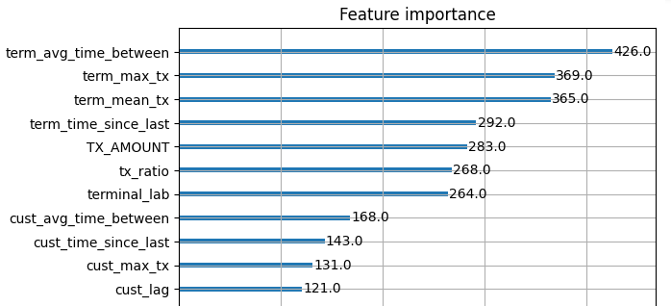
Modeling
Compared Decision Tree, Naïve Bayes, and XGBoost models.
XGBoost Significant Features
Decision Tree Representation

Slide 6
Results
Model | Parameters | F1 Score | AUC
Decision Tree | ccp_alpha = 0.01 class_weight={0:1,1:10} | 0.939 | 0.949
Naïve Bayes | Gaussian Kernel | 0.416 | 0.933
XGBoost | subsample=0.9 early_stopping = 20 | 0.945 | 0.999
Transaction amount is the most significant factor
Terminal usage can also be used to flag suspicious behavior
Fraudulent transaction detection is an approachable classification problem

